Slide 2
Victoria Golf Club
Voted Golf Shop of the Year 2013

Slide 3
Victoria Golf Club
Voted Golf Shop of the Year 2013

Slide 4
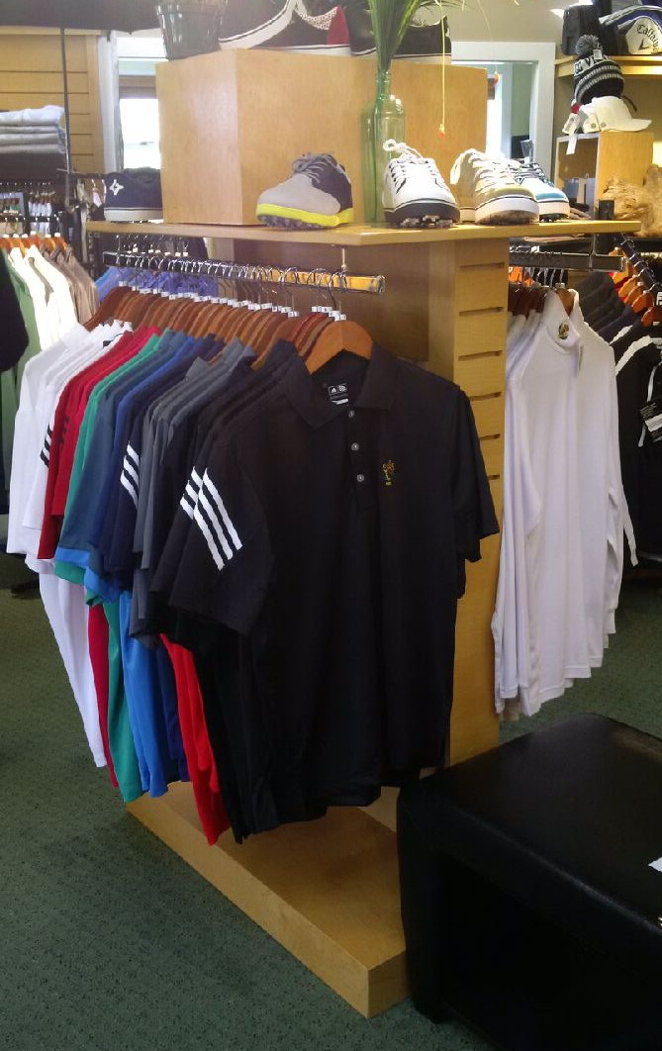
Victoria Golf Club
Voted Golf Shop of the Year 2013

Slide 5
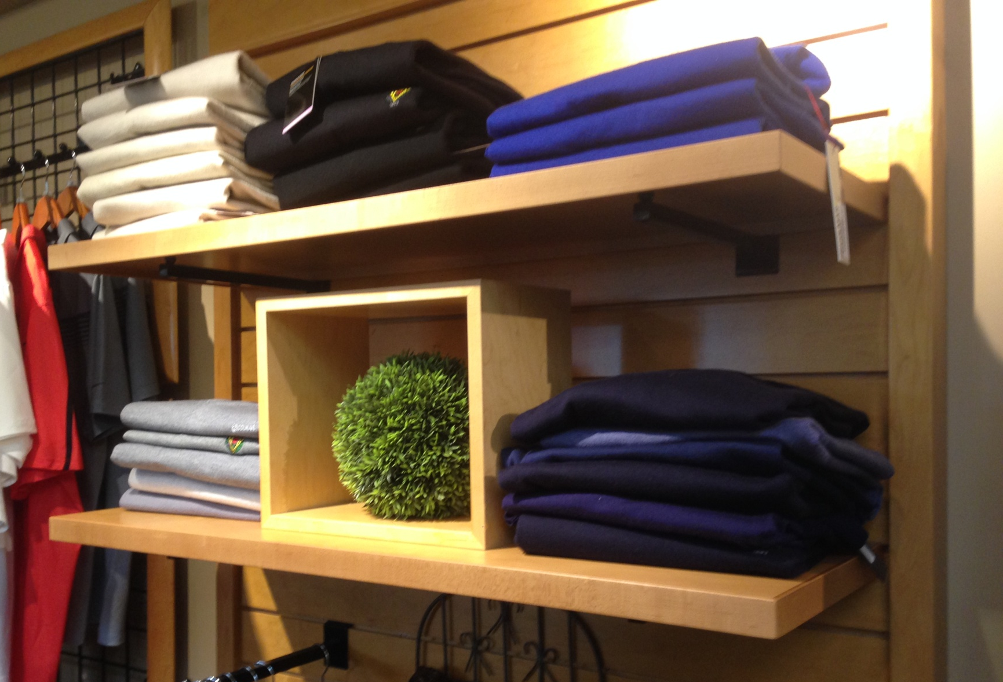
Victoria Golf Club
Shelving Project May 2015

Slide 6
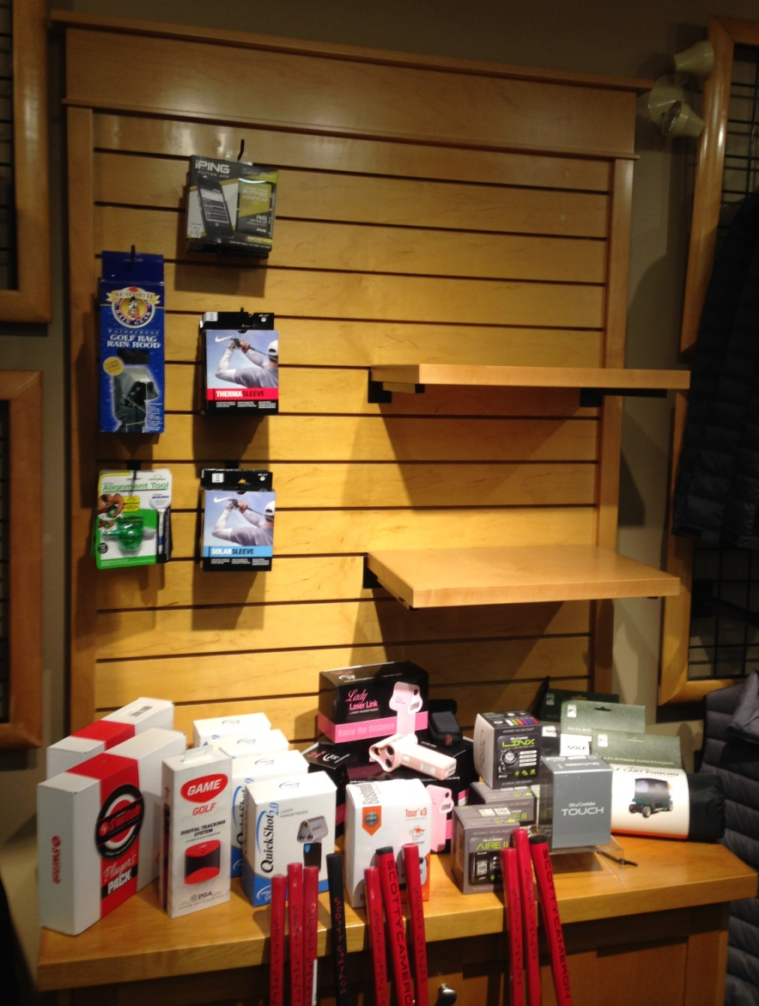
Victoria Golf Club
Shelving Project May 2015

Slide 7
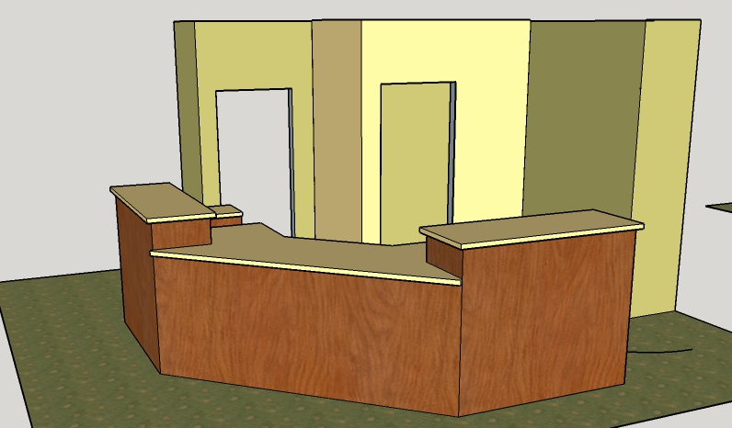
Olympic View - GolfBC
Counter Relocation Project – June 2015

Slide 8
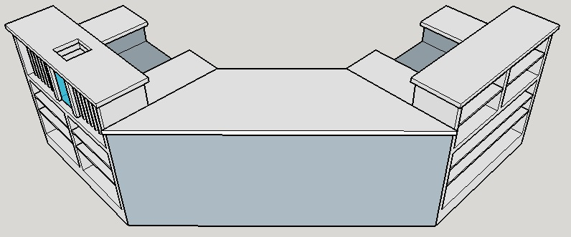
Olympic View - GolfBC
“VB Golf understood what we wanted and needed.
They looked at our budget and got the
Most Value out of our new counter!”
Counter Relocation Project

Slide 9
Olympic View - GolfBC
Counter Relocation Project

Slide 10
“We love our new counter here at Olympic View! Our shop has been getting tons of great feedback from the layout.”

Slide 11
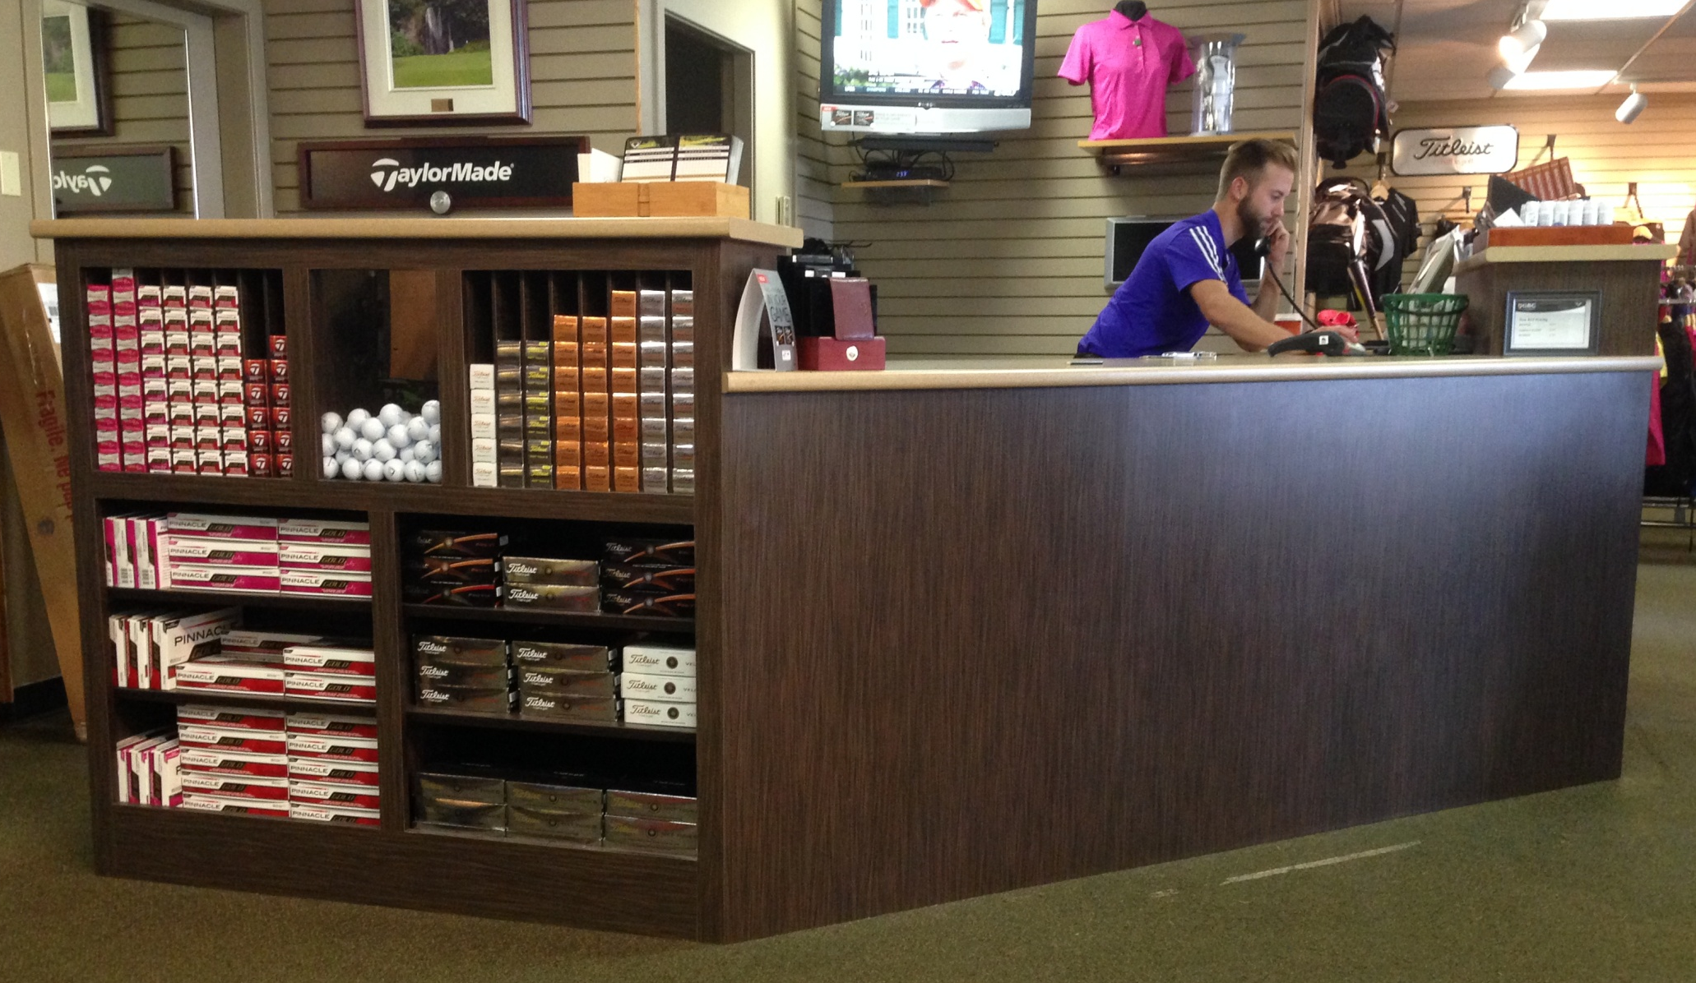
Olympic View - GolfBC
Counter Relocation Project

Slide 12
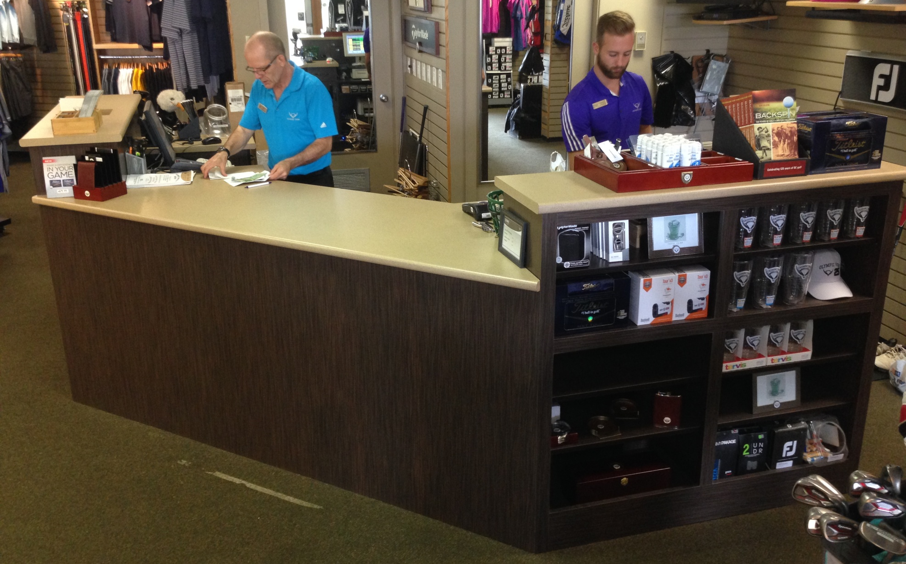
Olympic View – GolfBC
Counter Relocation Project

Slide 13
Olympic View - GolfBC
We love our new counter here at Olympic View! Our shop has been getting tons of great feedback from the layout. Our New counter is the perfect focal point for our selling space.
Working with Sam over the past few months has been a breeze.
She was Professional, informative and supportive. I felt that there was no way I wasn’t going to be successful with this project!
VB Golf understood what we wanted and needed. They looked at our budget and got the Most value out of our new counter!
This Counter is a gift that will be used and appreciated for many years to come.
Kevin Maxwell | Head Professional
Counter Relocation Project

Slide 14
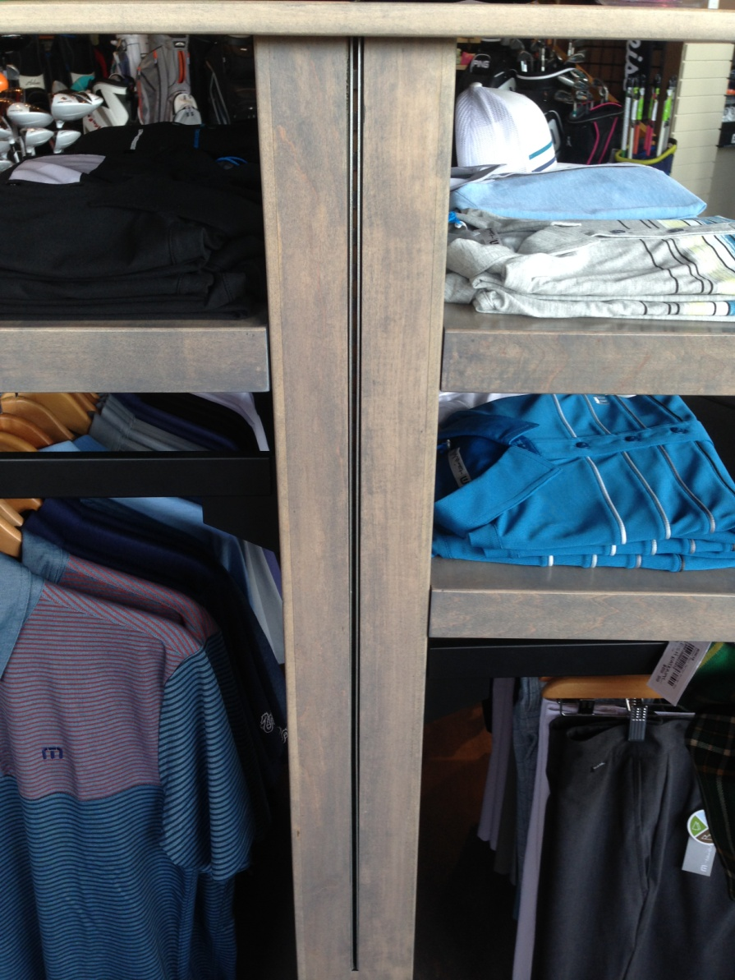
Kelowna Golf & Country Club
Custom Hybrid Design for Space Efficiency

Slide 15
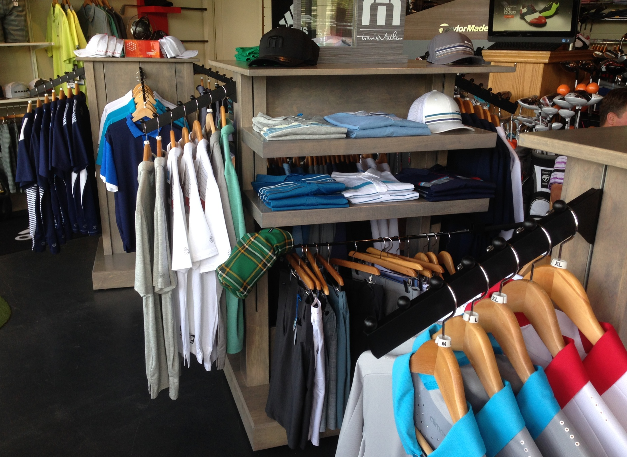
Kelowna Golf & Country Club

Slide 16
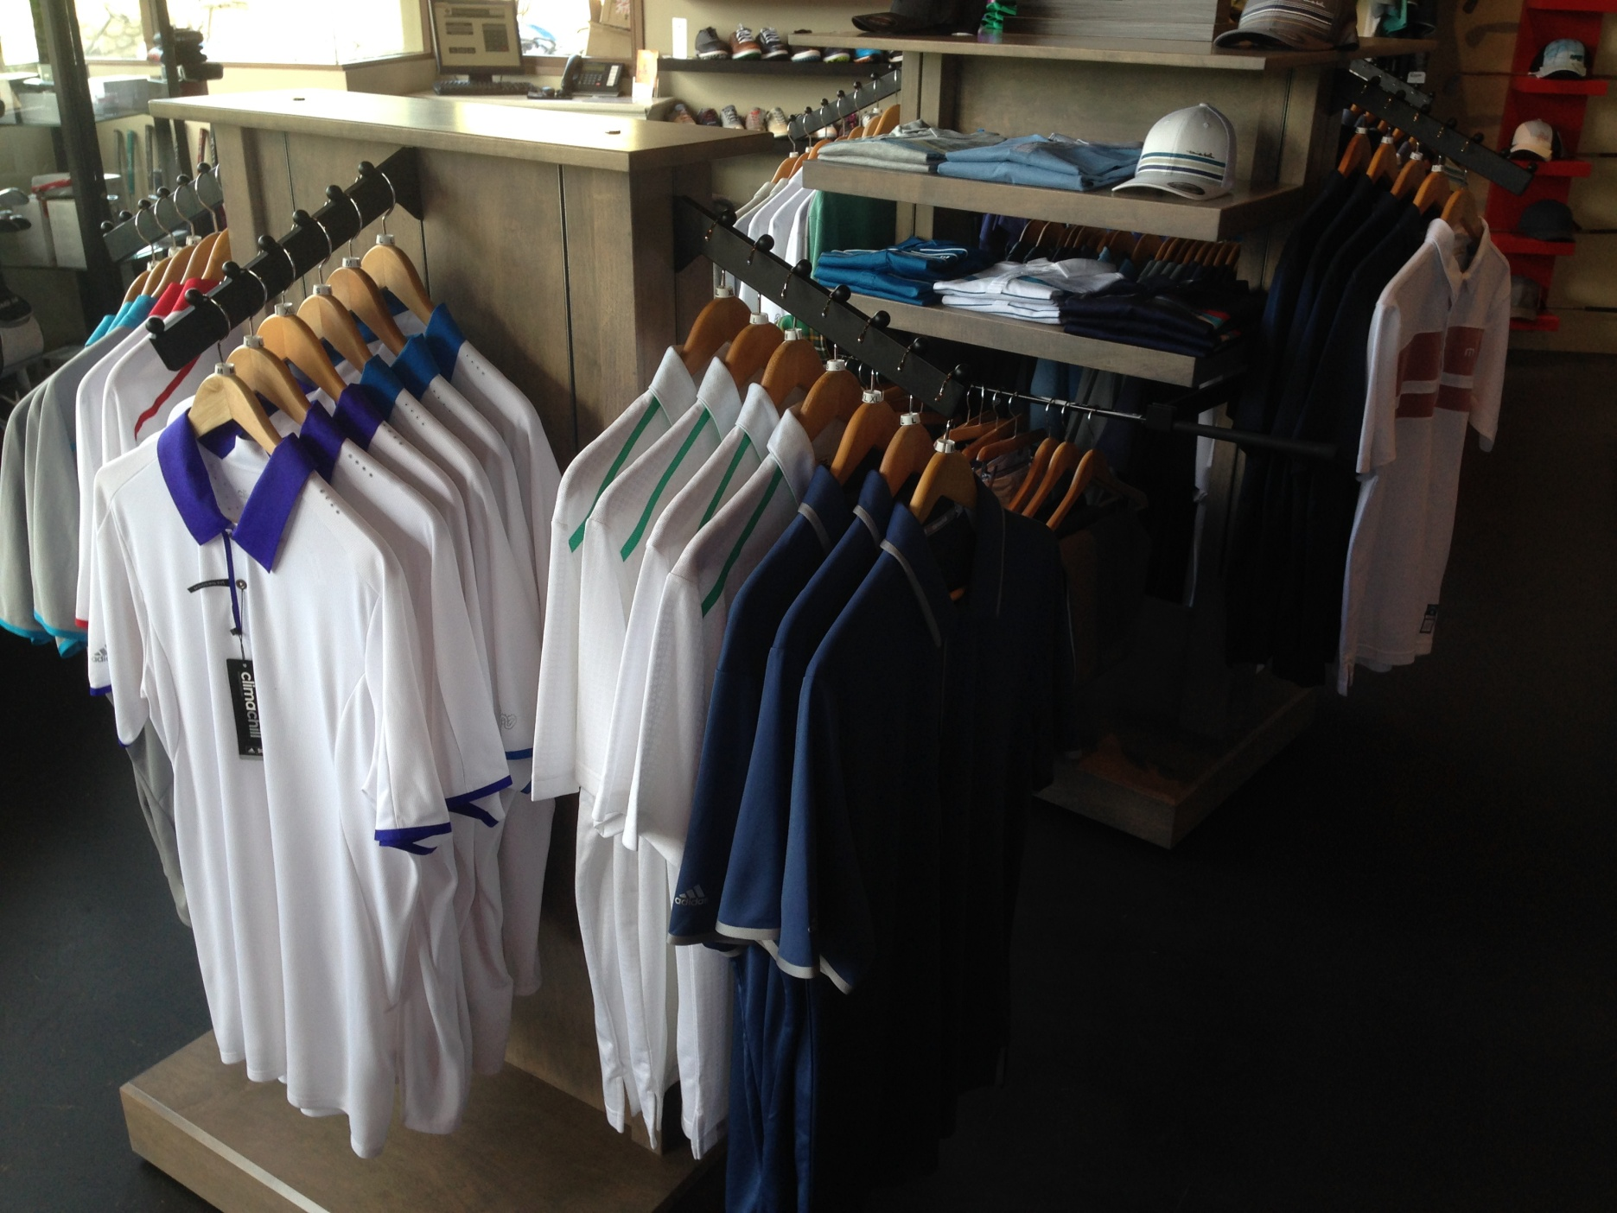
Kelowna Golf & Country Club

Slide 17
Kelowna Golf & Country Club

Slide 18
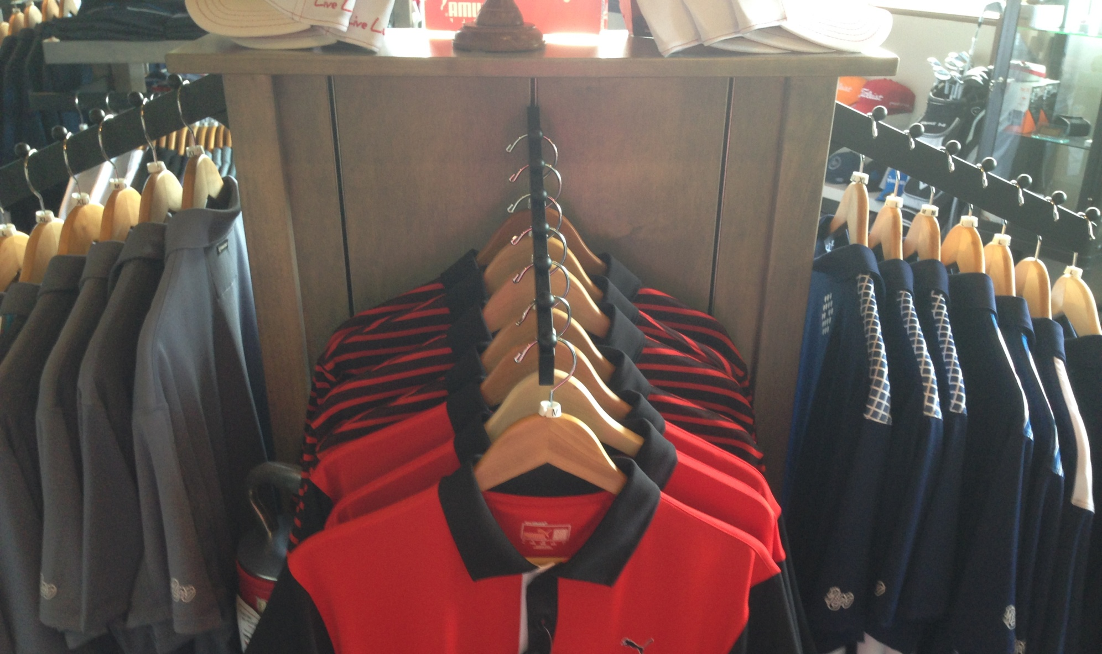
Kelowna Golf & Country Club
Custom Hybrid Design for Space Efficiency

Slide 19
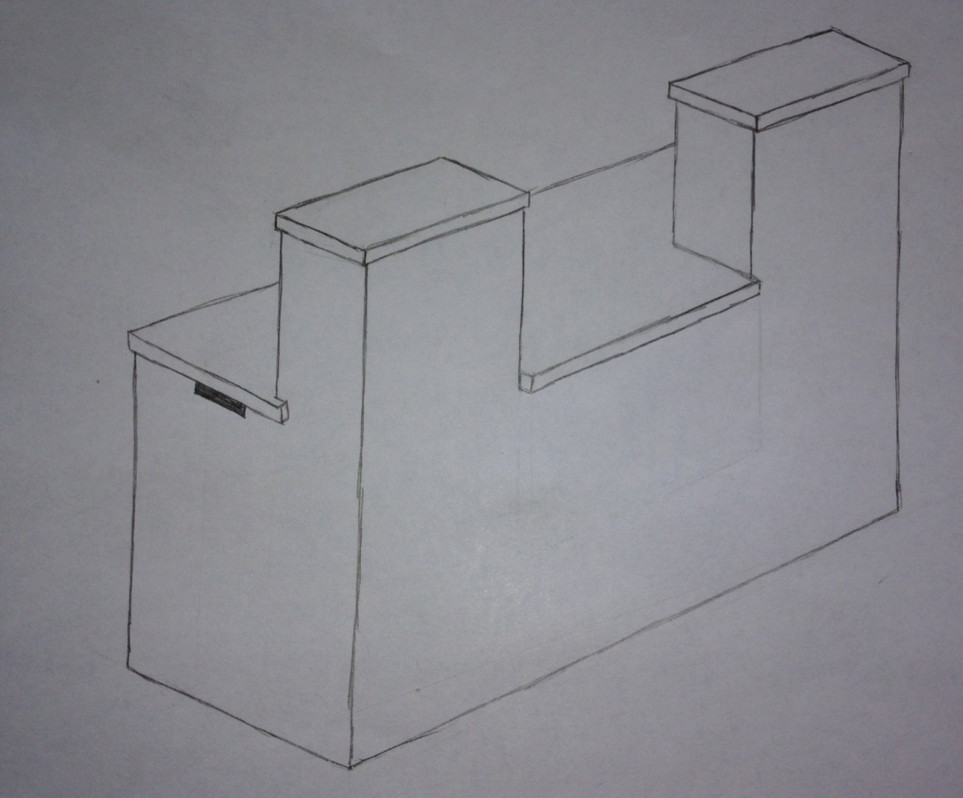
Arbutus Ridge Golf Club
Counter Relocation & Reduction Project

Slide 20
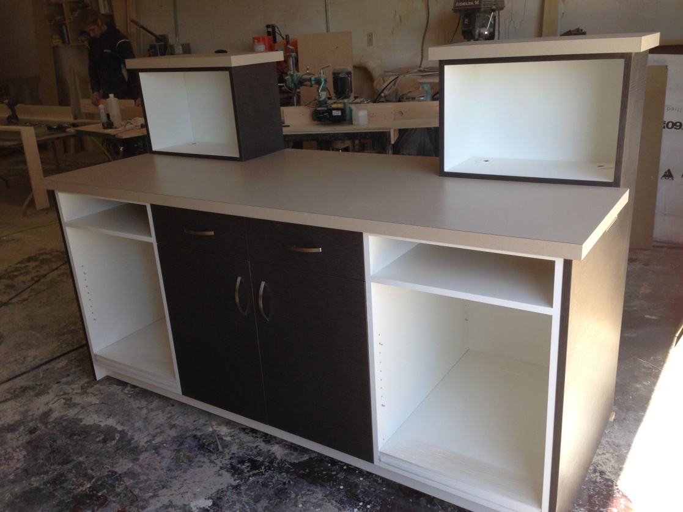
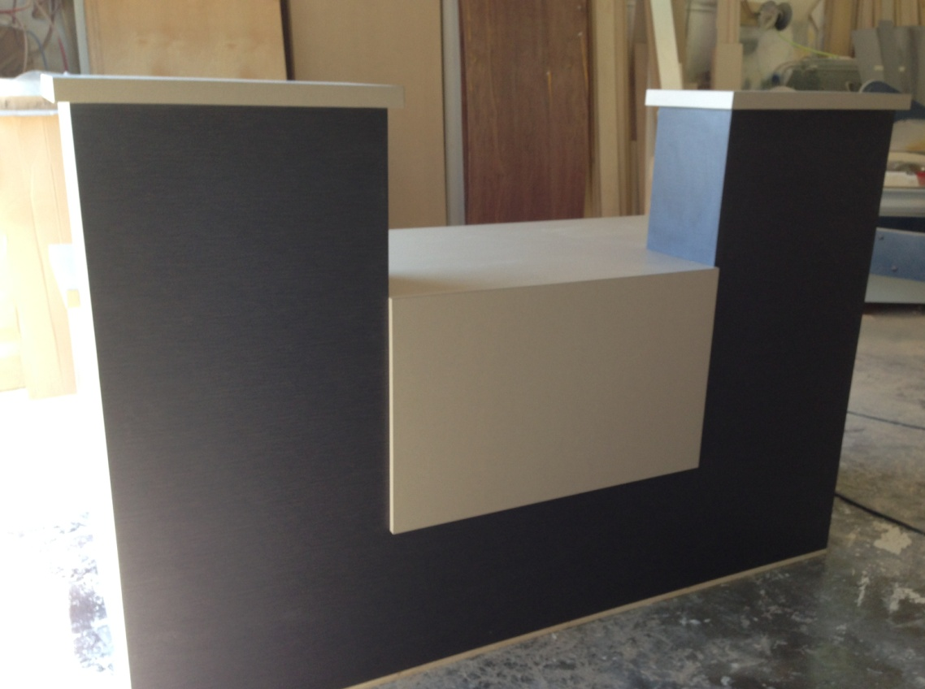
Arbutus Ridge Golf Club
Counter Relocation & Reduction Project

Slide 21
“The amazing comments from our members and regular public confirmed: The final product was worth our investment!”

Slide 22
Arbutus Ridge Golf Club
Working with Fresh Golf Solutions was one of the easiest projects I worked on this year. Due to their professional, systematic and thorough approach they developed an attractive, functional counter that is now the centre piece of our golf shop.
What I'm most thankful for is all the small details that they made sure were present in the design before construction. Without her expertise there would have been many adjustments costing time and money.
The amazing comments from our members and regular public confirmed that the final product was worth our investment. Richard Ingle Head Golf Professional | Arbutus Ridge Golf Club
Counter Relocation & Reduction Project

Slide 23
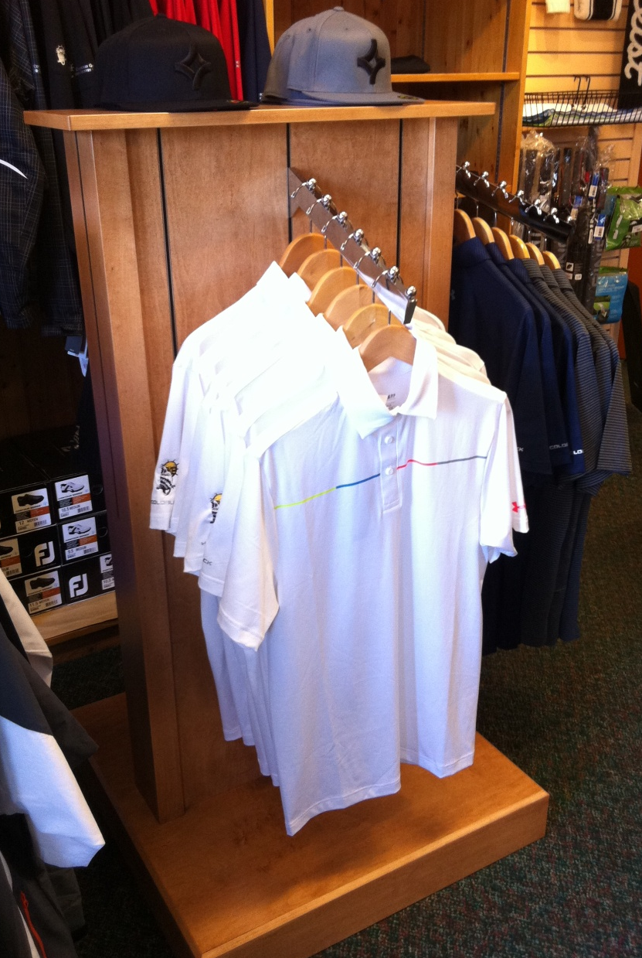
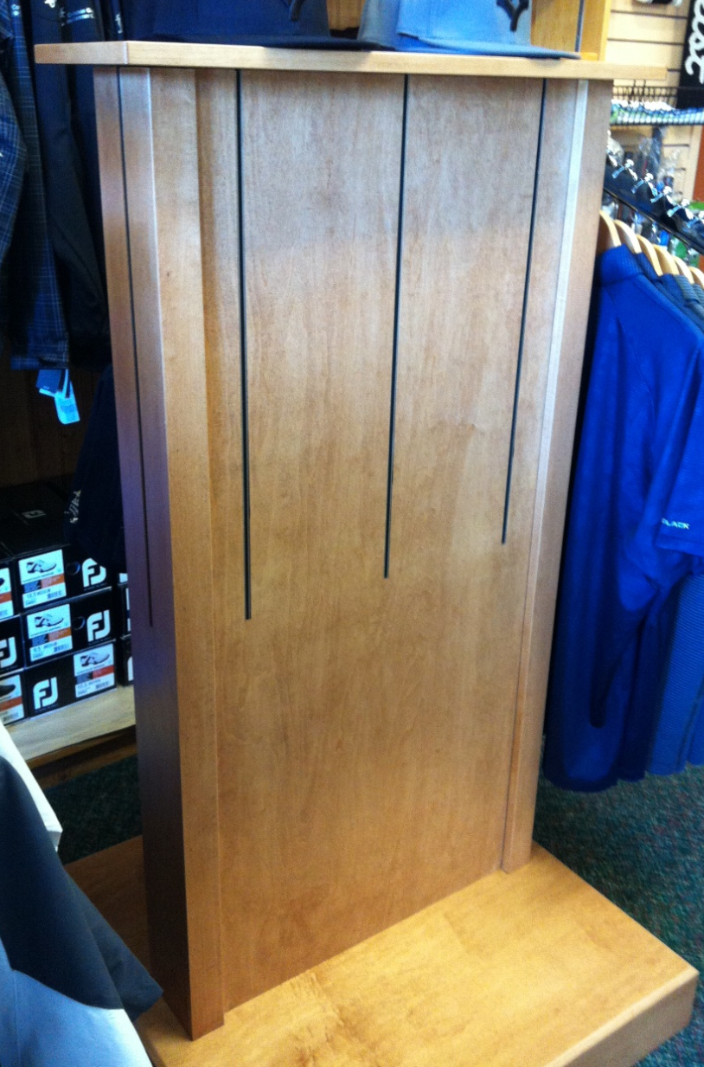
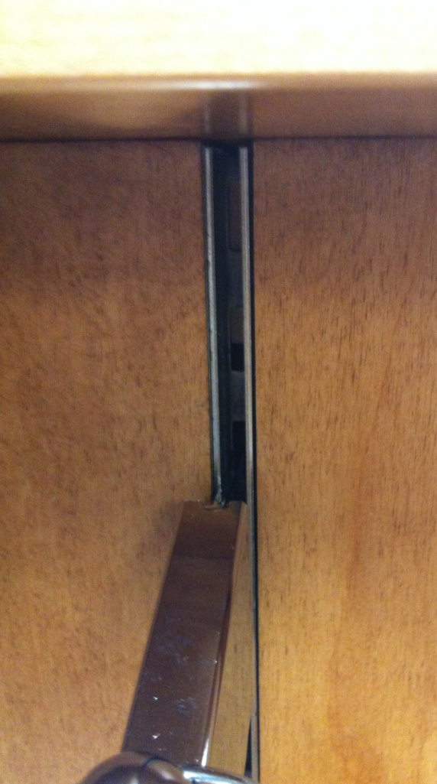
Cowichan Golf Club

Slide 24
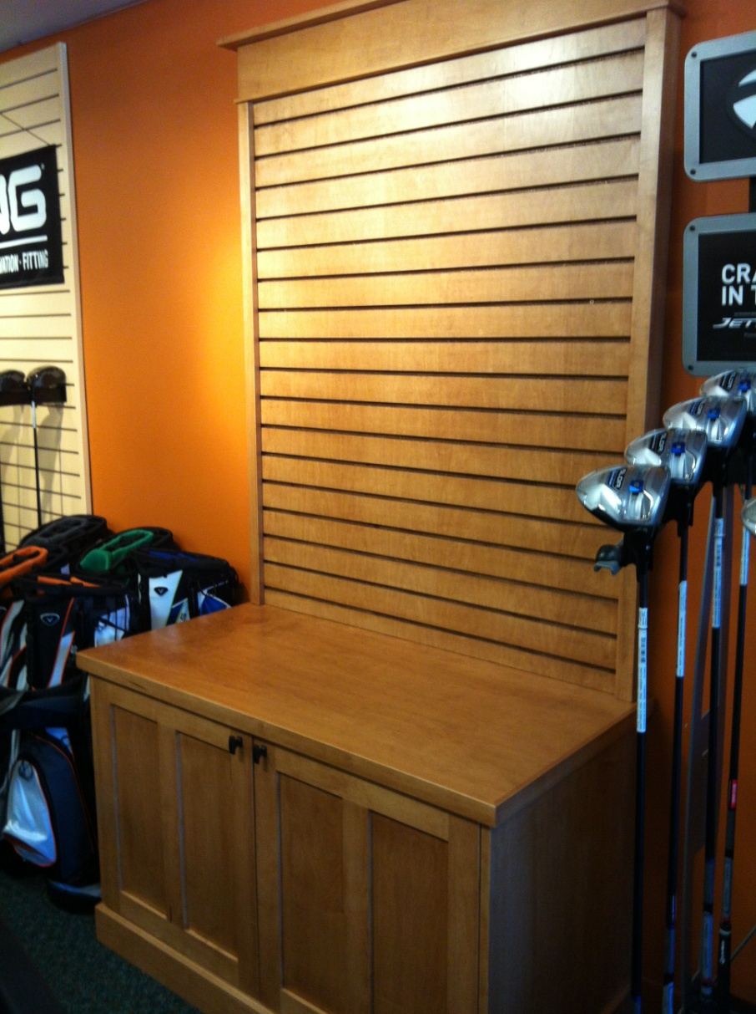
Cowichan Golf Club

Slide 25
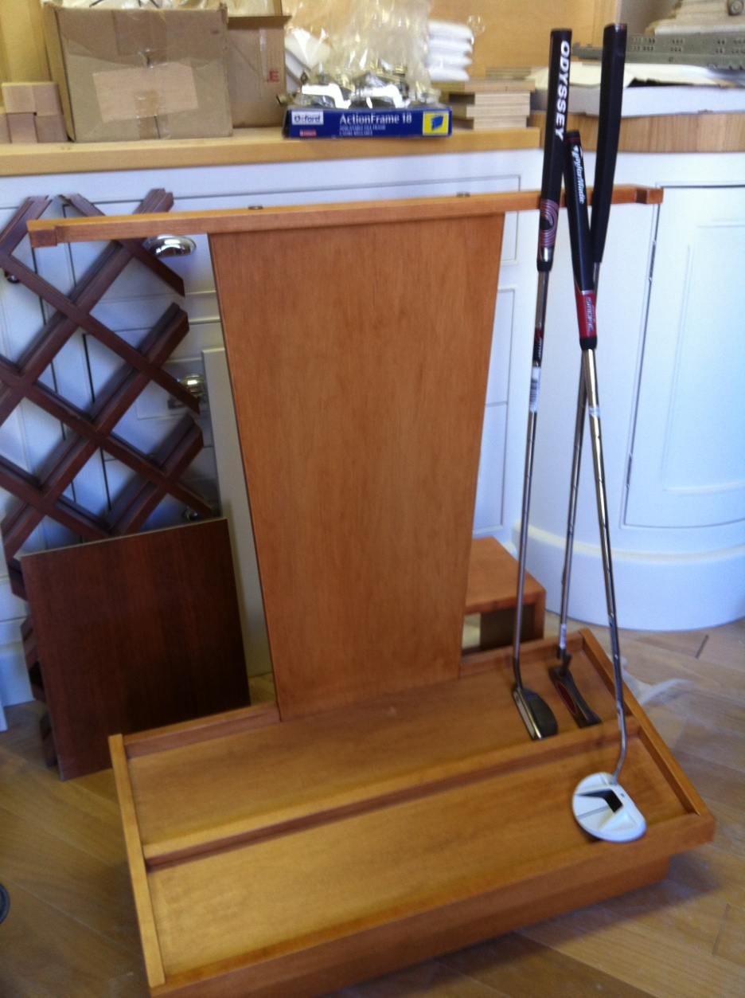
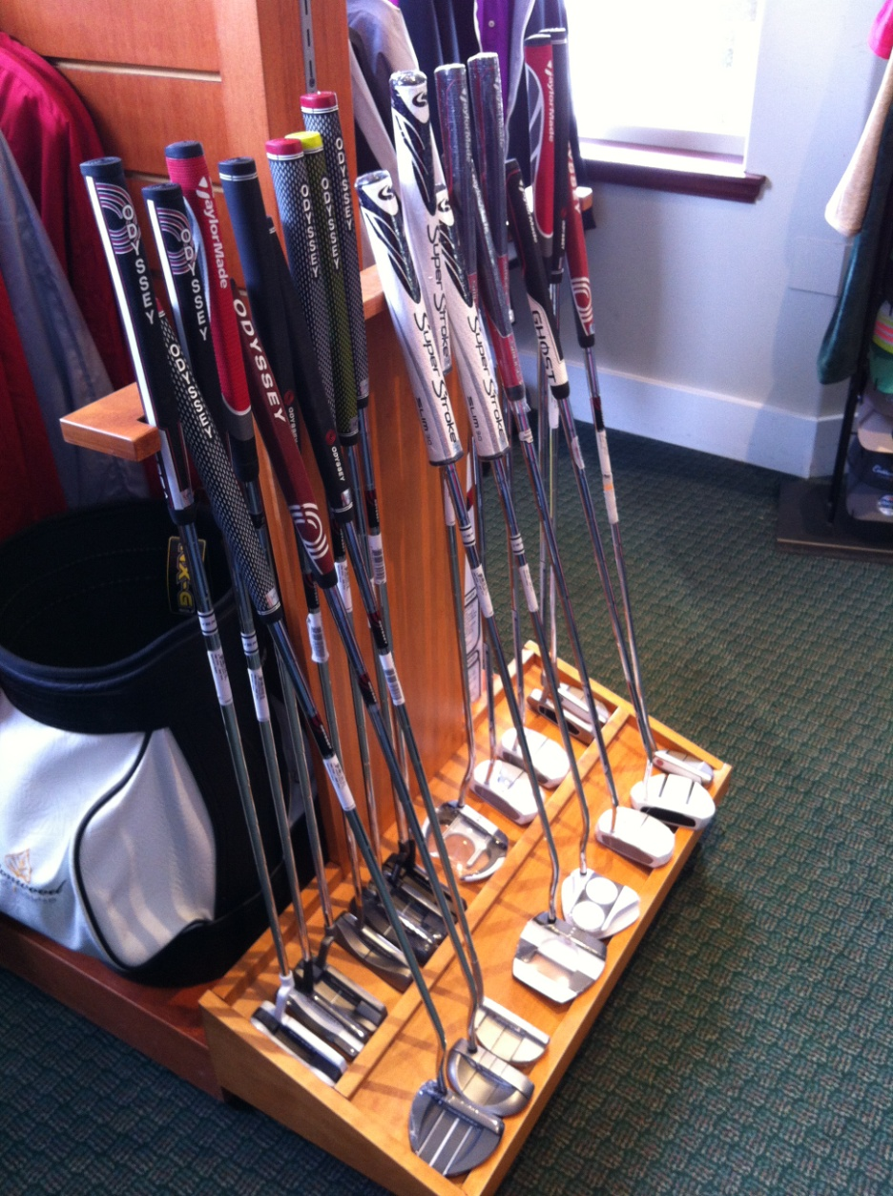
Cottonwood Golf Course
Maximize Efficiency of Limited Retail Space

Slide 26
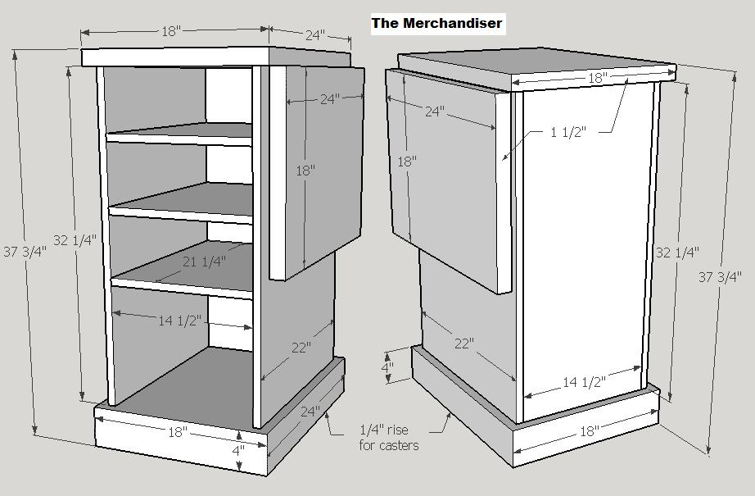
New Designs & Projects
Custom and Hybrid Pieces

Slide 27
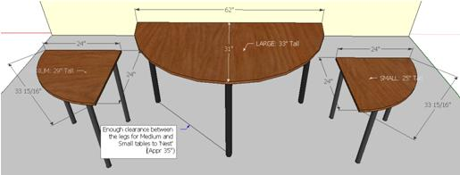
New Designs & Projects
Half & Quarter Round Nesting Tables

Slide 28
New Designs & Projects
Standard Nesting Tables

Slide 29
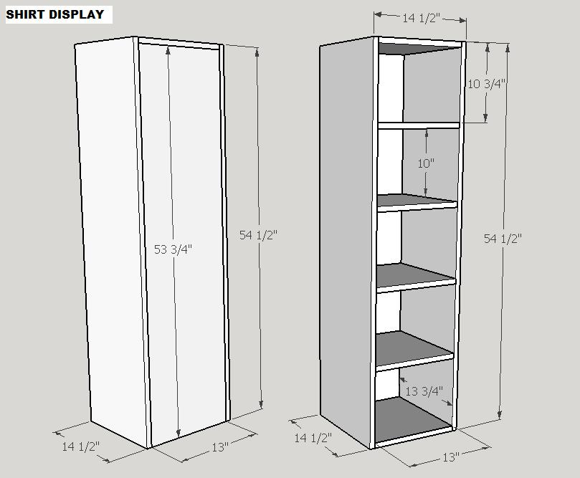
New Designs & Projects
Custom and Hybrid Pieces

Slide 30
November 22nd -26th

Slide 31
November 22nd -26th
The Worlds Largest Pro-Am has room for a few more Teams & Individual amateurs!
The 14th Annual trip to the Desert includes:
- Accommodation at Paris Hotel & Casino
- 3 Rounds at Nevada’s Best Courses
- Cocktail parties & Bus transfers
- Tee-gifts & Prize Pots

